Slide 1
Improving Efficiency for String Similarity Searches through Clustered Pruning
Kyle Patterson, James Fitzpatrick
EECS 405, Spring 2014

Slide 2
Original Idea
Comparing VGRAM and Top-K
Build clusters on strings based on LCS
Trim search space by clusters
Compare Naïve VGRAM/Top-K versus trimmed search space

Slide 3
Problems!
Clustering was way too difficult for the time and computing restraints
Tried building an Inverted List based on LCS instead, similar to clustering
List construction was doable, but very expensive in memory and time
Could be useful for situations with low amounts of memory or very large data sets, but not in general case

Slide 4
String Similarity
Many Different Approaches
Utilize Edit Distance Comparisons
Each operation that leads from string s to query string q increased ED by 1
Insertion
Deletion
Substitution
Top-K and VGRAM both use tries to reduce search space

Slide 5
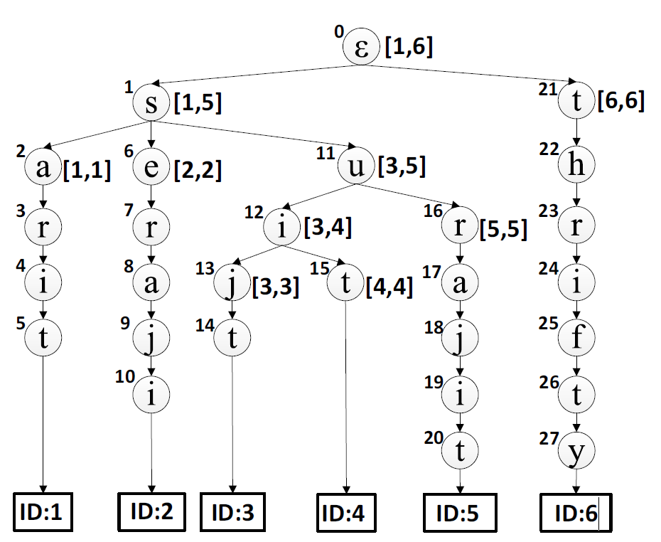
Top-K Concepts
Pivotal Top-K Search
Split each string into individual characters
Add each string to a master trie
Similar prefixed strings descend from same parents
Works well for many short strings that have similar prefixes/suffixes
Experimentally: Does not work well for long, unique strings

Slide 6
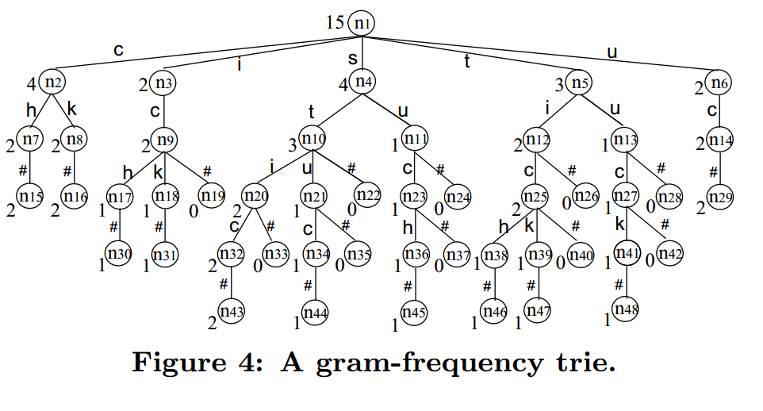
VGRAM Concepts
Divide each string into grams of variable length [min, max]
Associate each string with its VGRAMS
When searching, divide query into its longest length v-grams
Terms that share more v-grams are more similar to q

Slide 7
VGRAM Concepts
Positional VGRAM
Variation on VGRAM
Utilizes positional data to distinguish the VGRAMs more
Location of grams may be a distinguishing feature of datasets
Pruning
Reduce the search space further by removing inconsequential VGRAMS
Reduce long unique VGRAMs to shorter equally significant ones
Remove long and frequent VGRAMs, but keep most unique substrings

Slide 8
Clustering Concepts
Data clustering involves grouping a data set based on similarity of attributes
A good clustering method will produce clusters with
high intra-class similarity
low inter-class similarity

Slide 9
BIRCH: Balanced Iterative Reducing and Clustering Using Hierarchies
Designed for very large data sets
Time and memory are limited
Only one scan of data is necessary
Two key phases:
Scans the database to build an in-memory tree
Applies clustering algorithm to cluster the leaf nodes

Slide 10
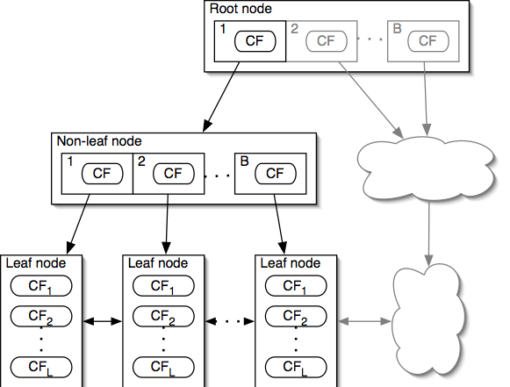
CF - Tree
BIRCH Algorithm
Each non-leaf node has at most B entries
Each leaf node has at most L CF entries, each of which satisfies threshold T
Node size is determined by dimensionality of data space and input parameter P (page size)

Slide 11
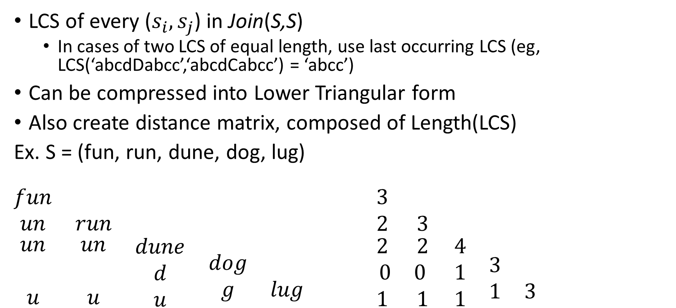
Difference Matrix
LCS of every ($s_{i},s_{j}$) in Join(S,S)
In cases of two LCS of equal length, use last occurring LCS (eg, LCS(‘abcdDabcc’,‘abcdCabcc’) = ‘abcc’)
Can be compressed into Lower Triangular form
Also create distance matrix, composed of Length(LCS)
Ex. S = (fun, run, dune, dog, lug)
$$\begin{matrix}fun & & \begin{matrix} & & \end{matrix} \\ un & run & \begin{matrix} & & \end{matrix} \\ \begin{matrix}un \\ \\ u\end{matrix} & \begin{matrix}un \\ \\ u\end{matrix} & \begin{matrix}\begin{matrix}dune \\ d \\ u\end{matrix} & \begin{matrix} \\ dog \\ g\end{matrix} & \begin{matrix} \\ \\ lug\end{matrix}\end{matrix}\end{matrix} \begin{matrix}3 & & \begin{matrix} & & \end{matrix} \\ 2 & 3 & \begin{matrix} & & \end{matrix} \\ \begin{matrix}2 \\ 0 \\ 1\end{matrix} & \begin{matrix}2 \\ 0 \\ 1\end{matrix} & \begin{matrix}\begin{matrix}4 \\ 1 \\ 1\end{matrix} & \begin{matrix} \\ 3 \\ 1\end{matrix} & \begin{matrix} \\ \\ 3\end{matrix}\end{matrix}\end{matrix}$$

Slide 12
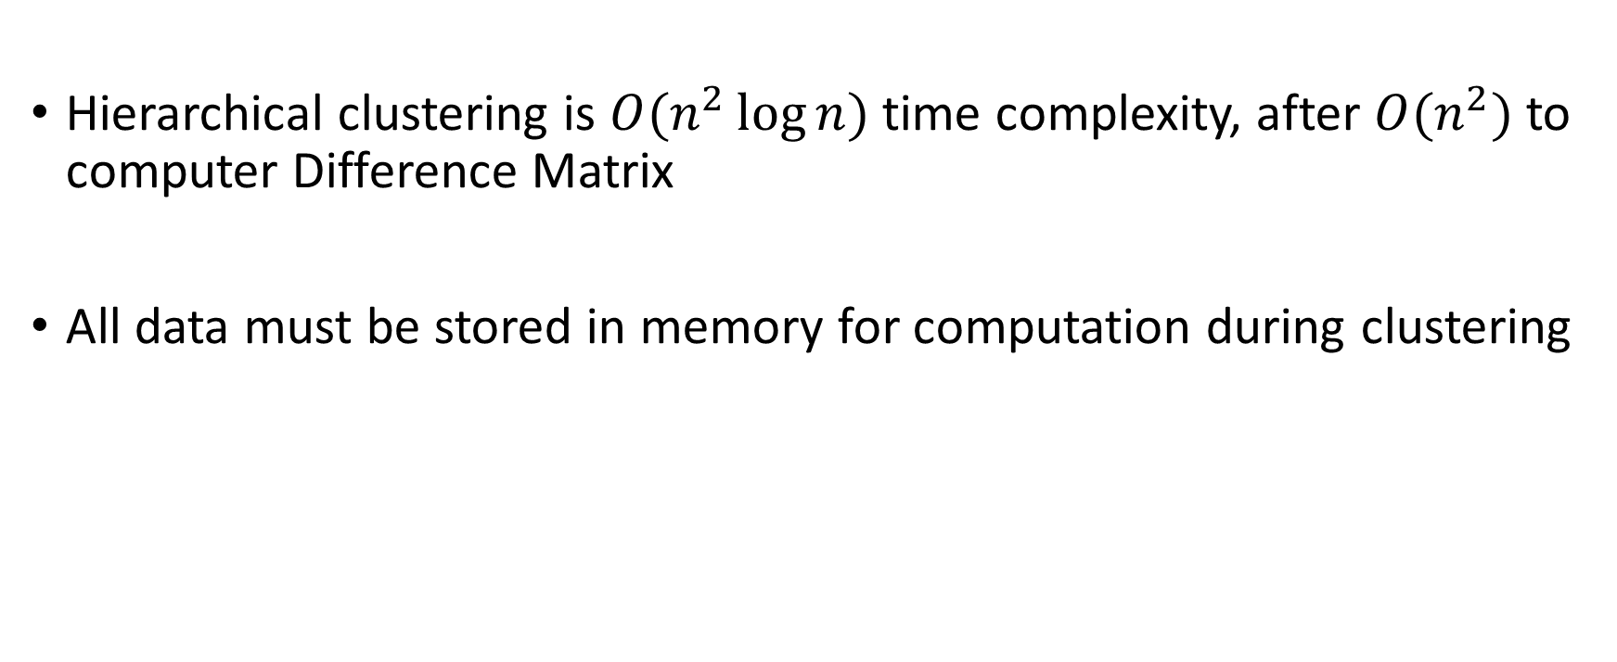
Problems with Clustering Technique
Hierarchical clustering is $O(n^{2}\log{n})$ time complexity, after $O(n^{2})$ to computer Difference Matrix
All data must be stored in memory for computation during clustering

Slide 13
Solution: Inverted List
Construct inverted lists from longest LCS to shortest LCS, will end up with tree-like structure
S = (fun, run, dune, dog, log) S = (fun, run, dune, dog,
log, doge, loge)
un
og
fun | run | dune
un
og
fun | run | dune
dog | log
dog | log
dog | doge
log | loge

Slide 14
Problems with Inverted List
Still requires difference matrix computation
Must enforce minimum query length to be useful, but minimum length is dependent upon data set
Most often will not be balanced!

Slide 15
Experiment Design
Naïve approach:
Construct Trie
Read query
Search Trie
Return results
Experimental Approach:
Read query
Search Inverted List for LCS subset
Construct Trie from subset
Search Trie
Return results

Slide 16
Experimental Setup
Data Sets:
S1: Subset of IMDB movie titles — 55,000 entries
S2: Subset of DBLP movie titles — 2.5 million entries
Testing run on Dell Latitude, i7 quad-core processor at 2.20GHz, 8 GB RAM

Slide 17
Preprocessing
S1 and S2 were cleansed to remove any non-ASCII entries (i.e, any string with a character outside of the [0,127] ASCII table)
Distance matrix for S1, S2 computed
S1 took approx. 2.5 hours to compute, 3.8 GB in size
S2 took approx. 10 hours to compute up to .5 million entries, ~7 GB in size

Slide 18
Testing
Trie Construction Time:
Randomly select subset of data in varying quantities
Construct Tries
Query Execution Time:
Select random strings from data set
Randomly edit selected strings within k edits
Query for edited strings

Slide 19
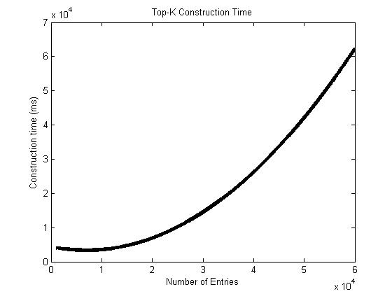
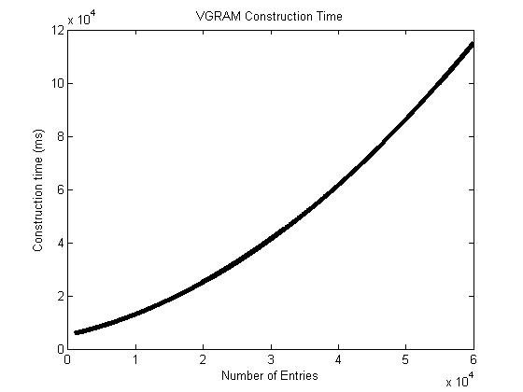
Trie Construction Times

Slide 20
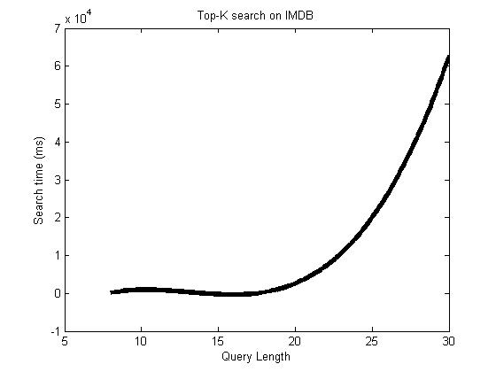
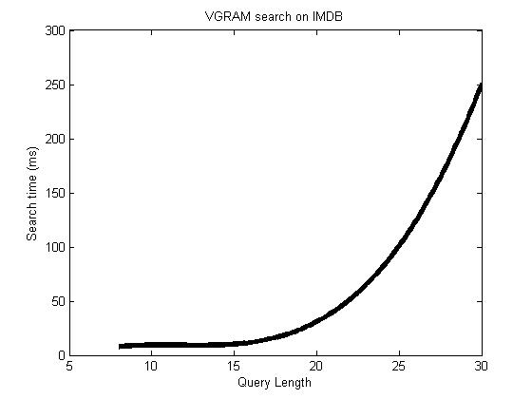
Query Time on IMDB – naïve

Slide 21
Conclusion
Clustering would probably be great, if it were less computationally expensive
Inverted Lists are also great, but constructing based on LCS is still very expensive
Search time of Inverted List could be reduced by sorting the data set according to LCS and storing memory pointers in the form [start, end]

